Slide 1
Ggplot2 and interactive graphics with R
Christophe Ladroue
SECTION 01
VIDEO 05
Using ggplot2 in a script
www.PacktPub.com

Slide 2
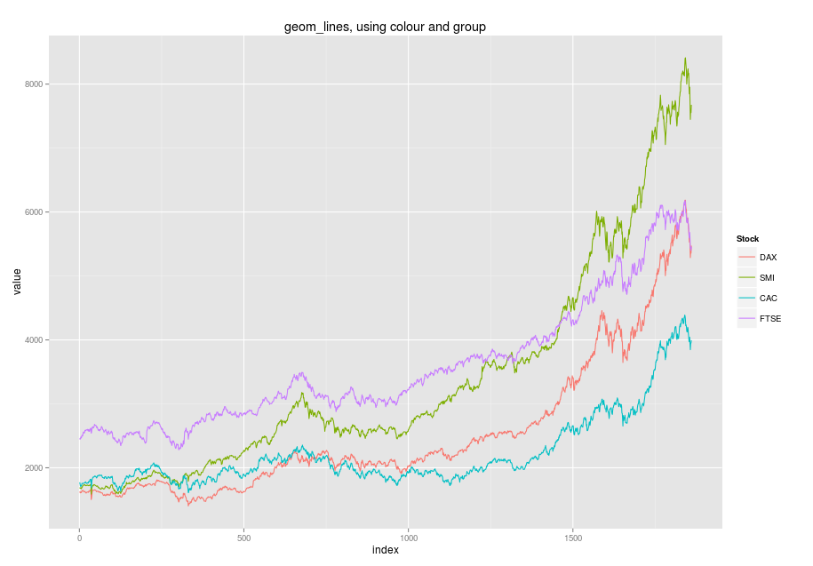
In this video we took a look at
how we can gradually build complex ggplot objects by storing them in a variable.
how to produce graphics from a script, rather than from the console.
Next: lines

